Slide 1

Rationale
Introduction to Windows Store App Development Using HTML5 and JavaScript
Computer science is a field of study that deals with solving a variety of problems by using computers.
  To solve a given problem by using computers, you need to design an algorithm for it.
Multiple algorithms can be designed to solve a particular problem.
An algorithm that provides the maximum efficiency should be used for solving the problem.
  The efficiency of an algorithm can be improved by using an appropriate data structure.
Data structures help in creating programs that are simple, reusable, and easy to maintain.
This module will enable a learner to select and implement an appropriate data structure and algorithm to solve a given programming problem.

Slide 2
Objectives
  In this session, you will learn to:
  Work with gesture events
Notes:
2

Slide 3

Handling Gesture Events
  The gesture events do not work like normal events.
  They follow a longer procedure to be identified.
  To handle gesture events in an app, you need to:
  Create an MSGesture object and associate it with the specific elements on which gestures need to be identified.
  Define event handlers for the various gesture events that occur on the defined targets.
  Associate event handlers with the specific gesture events.

Slide 4
Handling Gesture Events
(Contd.)
Let us look at an example, which handles gesture events in an app

Slide 5
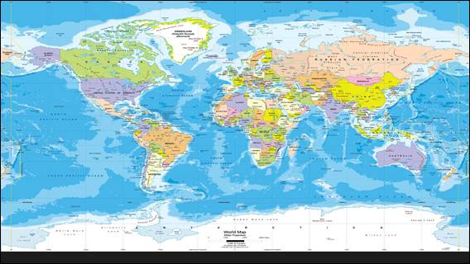

Demo: Handling Gesture Events
  Problem Statement:
  Jake, a software developer, has been assigned a task to develop an app, which displays the world map. The app should be designed to run on touch-enabled devices. Initially, Jake has designed the UI of the app that displays the world map, as shown in the following figure.

Slide 6
Demo: Handling Gesture Events (Contd.)
  Now, he wants to implement a functionality that allows the user to zoom in, zoom out, rotate, scroll, and scale the map.
  Help Jake in implementing the preceding functionality in the app.

Slide 7
Demo: Handling Gesture Events (Contd.)
  Solution:
  To implement the required functionality, Jake needs to perform the following tasks:
    1. Create gesture object.
    2. Associate gesture event handlers.
    3. Define gesture event handlers.
    4. Execute the app and verify the output.

Slide 8
Summary
  In this session, you learned that:
  To handle gesture events in an app, you need to:
    Create an MSGesture object and associate it with the specific elements on which gestures need to be identified.
    Define event handlers for the various gesture events that occur on the defined targets.
    Associate event handlers with the specific gesture events.
Notes:
8

Slide 9
What’s Next?
  You need to perform the following exercises of IWSADHJ Chapter 11 in the MR session:
  Exercise 1
  Exercise 2
  In addition, you need to perform Exercise 1 of IWSADHJ Chapter 12.

Slide 10

Q&A

